Slide 1
THE CONTRIBUTION OF BODY CENTER OF MASS VELOCITY TO BASKETBALL BALL RELEASE VELOCITY ACROSS SHOT DISTANCES
Casey Wiens¹ and Jill L. McNitt-Gray^{1,2} Departments of Biological Sciences¹ and Biomedical Engineering² University of Southern California Los Angeles, United States of America

Slide 2
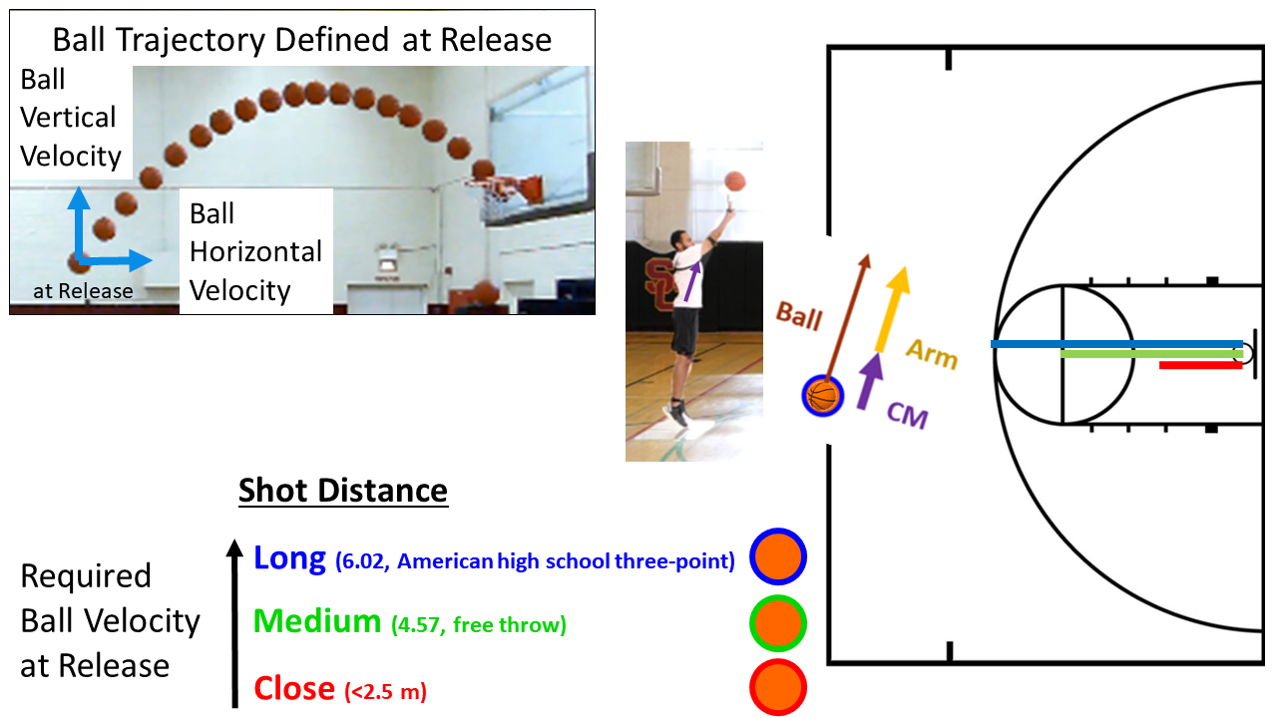
Mechanical Objectives of a Basketball Shot
Determinants of Success
More than one trajectory can result in success from same ball position
Ball velocity at release is determined by (Hay, 1978):
Body center of mass velocity
Velocity of ball relative to the body center of mass
Contributed to the arms
Center of mass vertical velocity at release increases with increase in shot distance
Miller and Bartlett, 1993
Okazaki and Rodacki, 2012

Slide 3
Does the Increase in Center of Mass Velocity at Release Reduce the Arm’s Contribution to Ball Velocity?

Slide 4
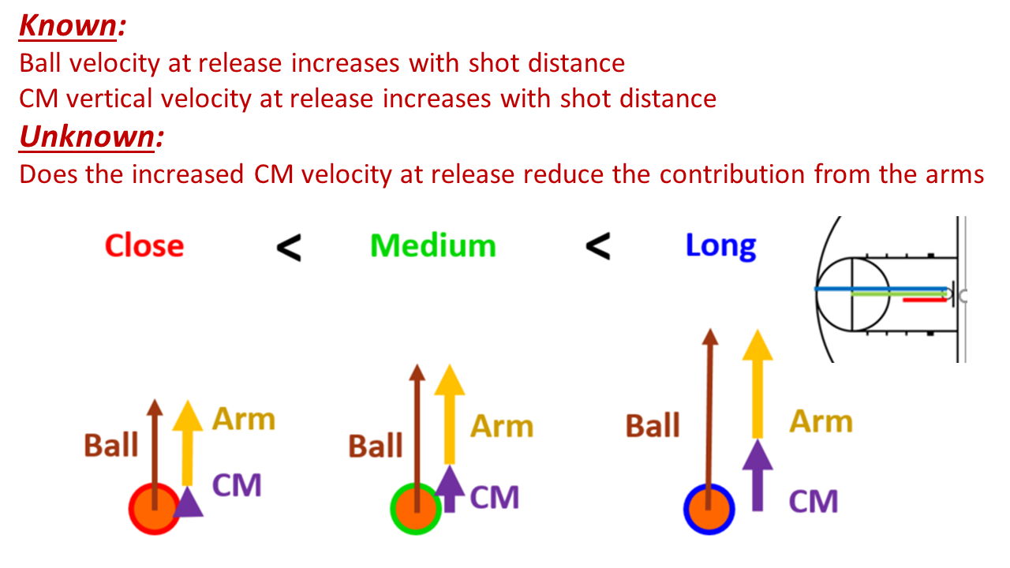
Contributions of CM Velocity to Ball Velocity at Release Across Shot Distances
Hypothesis
The greater the CM velocity at release, the greater % contribution of the CM velocity to ball velocity at release

Slide 5
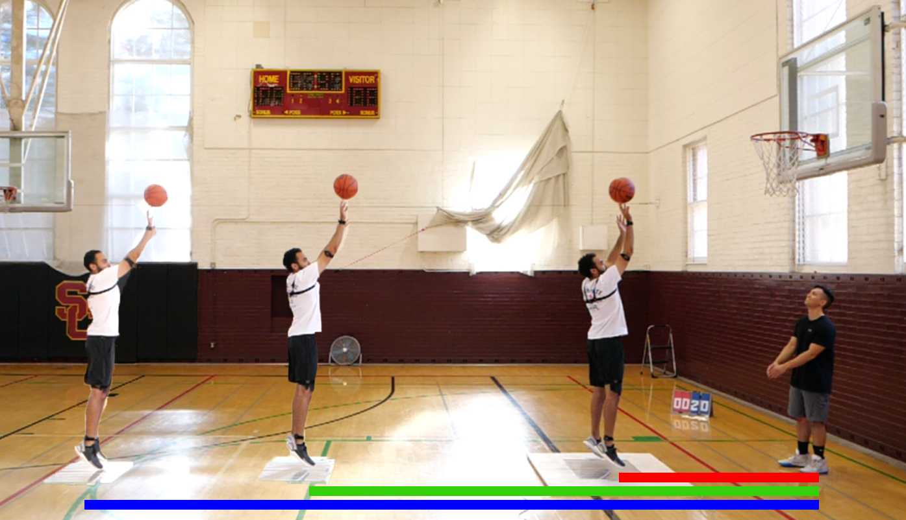
In the Gym Data Collection
Participants
7 recreational players
4 female
College aged
Basketball Shot at Game Pace
10 attempts from each distance
~ Static position on plates
Received pass from person under hoop
Motion Capture
Ball motion
Panasonic, 120Hz
Force-Time Characteristics
Net Impulse = Change in Momentum
CM Velocity at Release
Kistler, 1200Hz

Slide 6
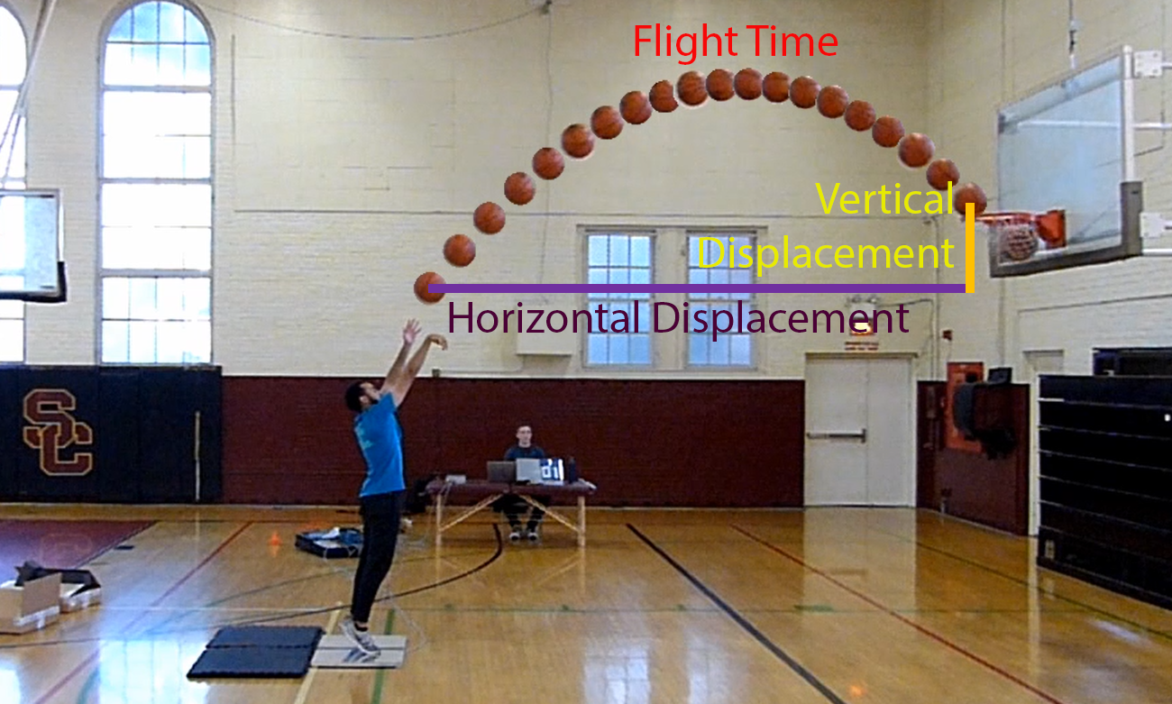
Ball Velocity at Release Determined by Flight Time and Ball Displacement

Slide 7
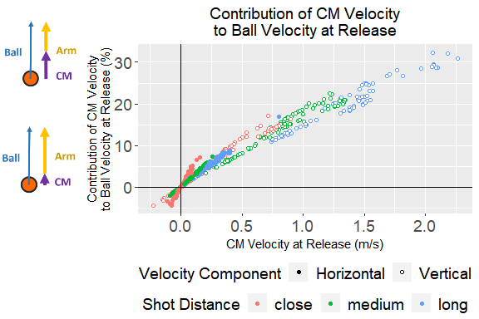
Results: If You Have It, You Use It
With greater shot distance, a greater ball velocity at release is needed
Having a greater CM velocity at release increases its contribution to ball velocity at release
This reduces the contribution required from the arms
This was consistent across all participants

Slide 8
How Can You Achieve a Greater CM Velocity at Release?

Slide 9
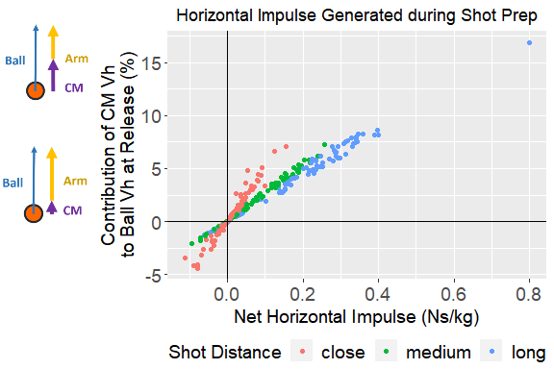
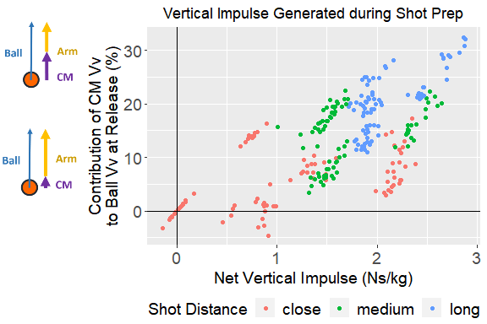
Greater Net Impulse during Shot Prep Affords Greater Potential for CM Velocity at Release

Slide 10
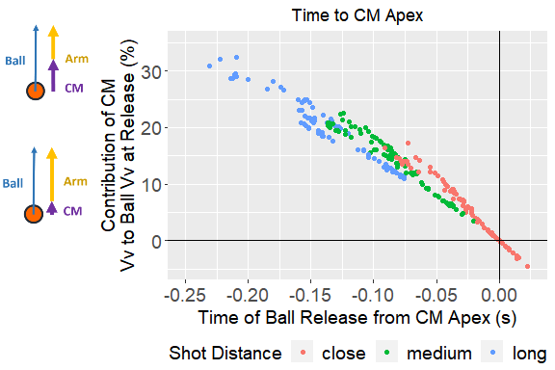
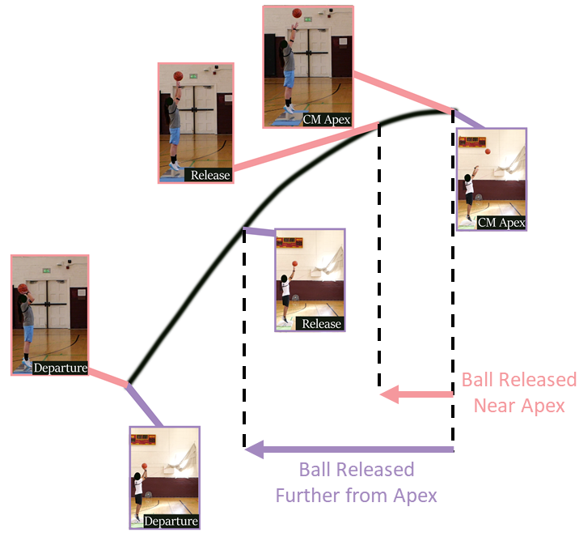
Ball Release Relative to the CM Apex Trajectory

Slide 11
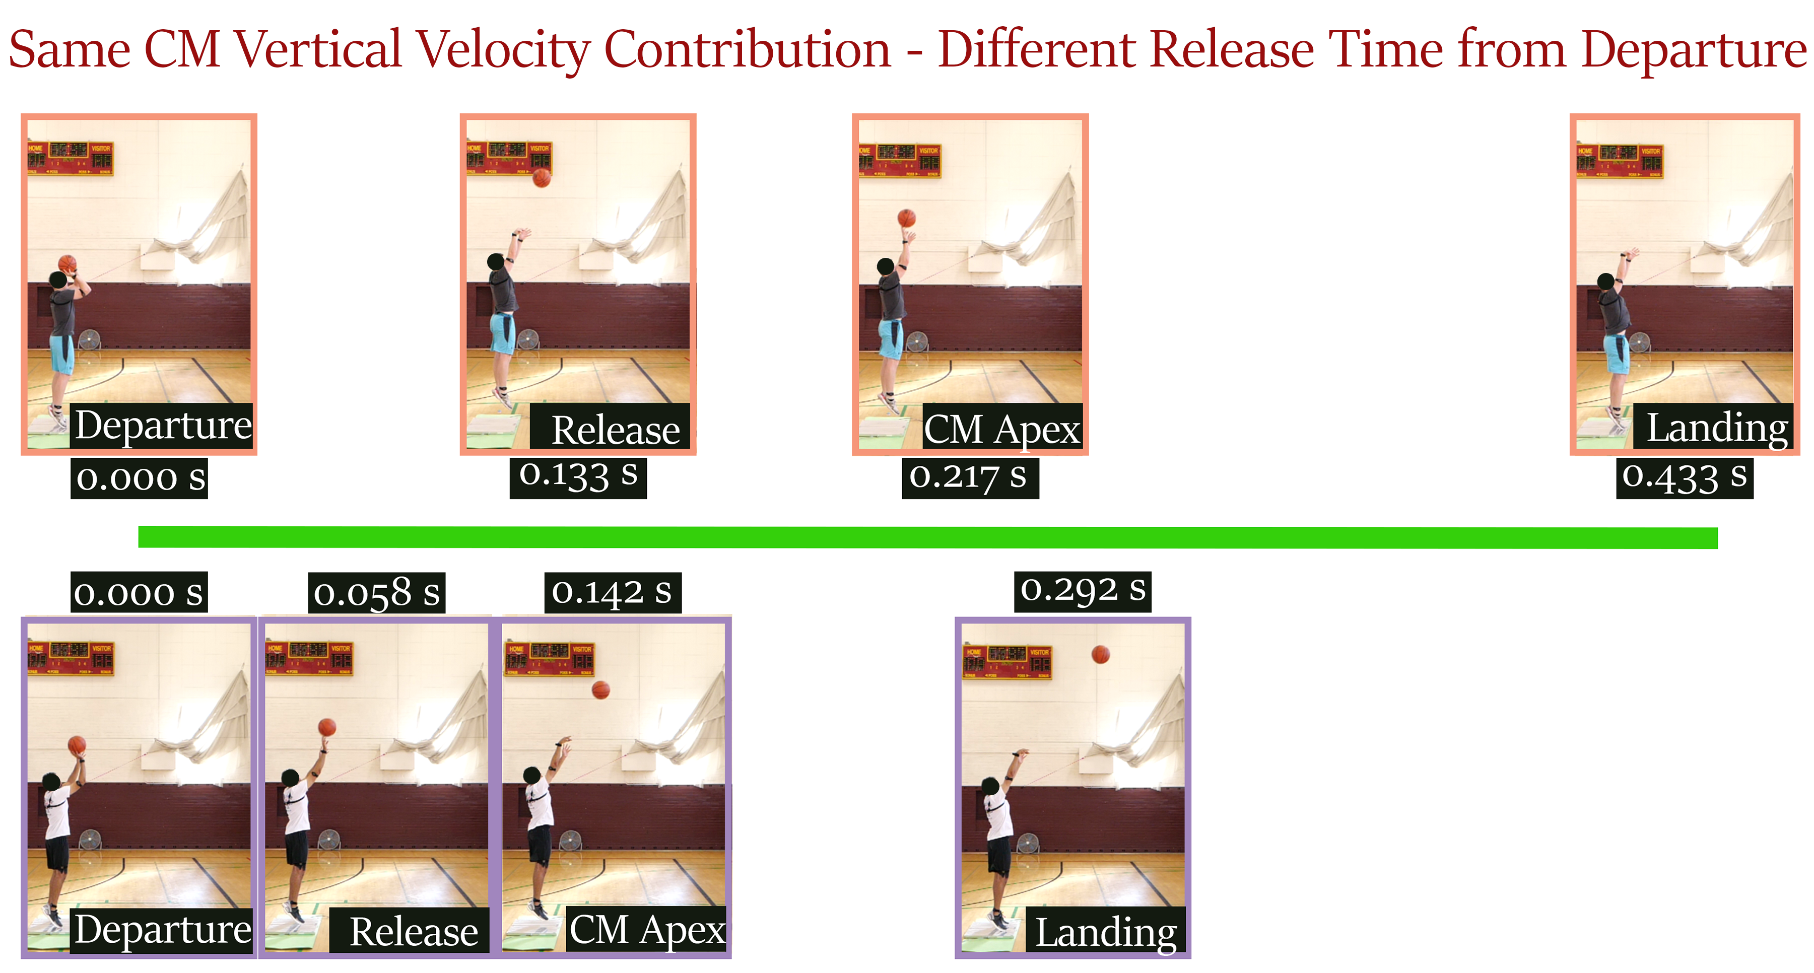
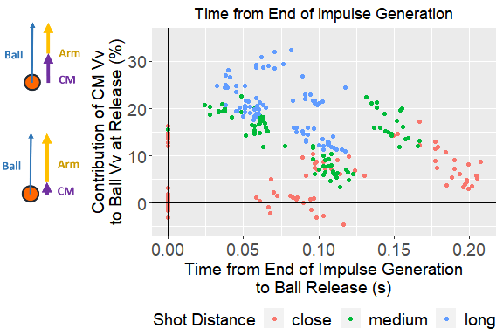
Using Time of Release Relative to End of Impulse Generation Is Less Clear

Slide 12
A Greater CM Velocity at Release Reduces the Contribution of the Arms to Ball Velocity
The greater the CM velocity at release, the greater % contribution of the CM velocity to ball velocity at release
Arm contribution decreased
As CM vertical velocity contribution to ball vertical velocity increased:
Ball was released earlier relative to apex of body CM trajectory
To increase CM velocity potentially available at release:
Increase impulse generated during shot preparation phase
Future directions
Increase sample size
Increase range of shooting skill level
Within-participant analysis
CM trajectory contributions to shooting accuracy
Effects of shooting while defended

Slide 13

Acknowledgements

